Slide 1

Radio Song Recognition & Tracking Web App
This system utilizes the Shazam API for automatic song recognition, enabling radio stations to efficiently record and track the music played on their airwaves through web application.
Saurav Shrestha AIML
Cohort-12

Slide 2

Introduction
1
The Problem
Radio stations face the challenge of manually tracking the songs they play, which can be time-consuming and prone to errors.
2
The Solution
This project aims to automate song recognition and tracking, providing radio stations with a reliable and efficient system.
3
Benefits
Automating the process saves time, improves accuracy, and provides valuable data for informed programming decisions.

Slide 3
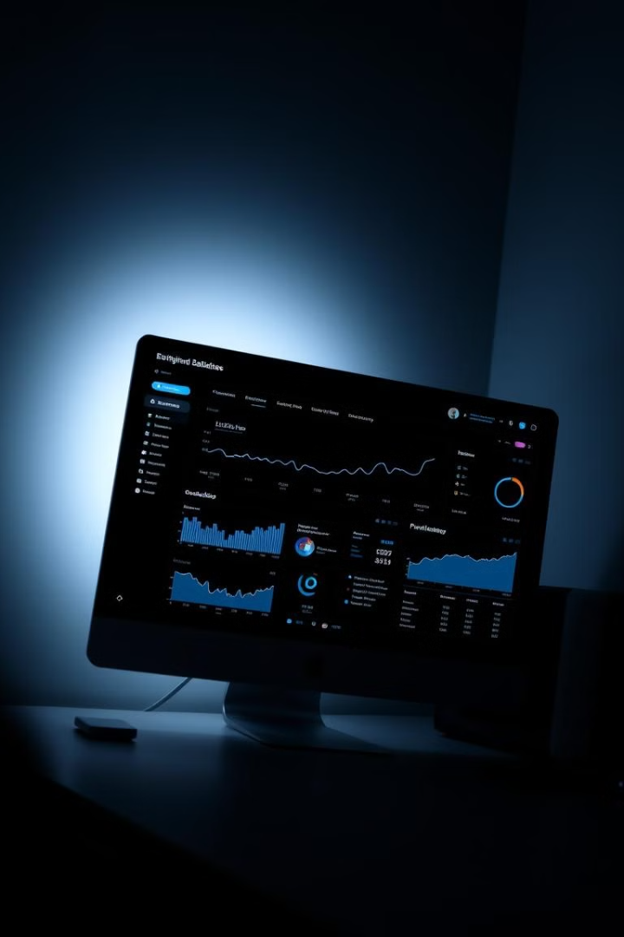
Project Overview
1
Real-Time Recognition
The system continuously monitors audio input from the radio station's broadcast stream, detecting and identifying songs playing in real-time.
2
Database Integration
Recognized songs are stored in a database, along with information such as artist, album, and play time.
3
Comprehensive Tracking
The system tracks the frequency of song plays, providing valuable data for programming decisions and listener insights.

Slide 4

Database Storage and Tracking
Song Metadata
The database stores essential song information such as artist, title, album, genre, and release date.
Play Count
The system tracks the number of times each song has been played, providing valuable data for analysis.
Play History
The database records the time and date of each song play, enabling historical analysis and trend tracking.

Slide 5
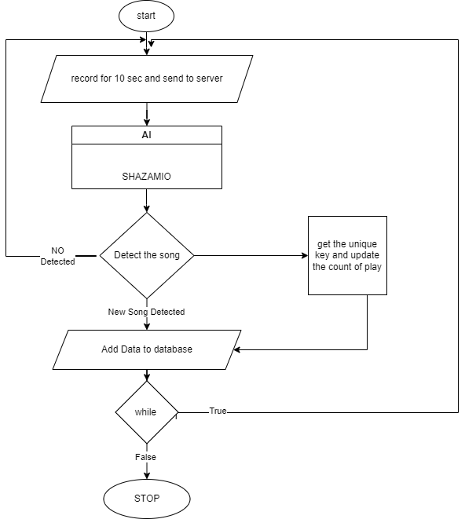
FLOW CHART

Slide 6
DEMONSTRATION

Slide 7
THANK YOU

